Slide 1
Parameter Estimation
Chapter 4

Slide 2


🔍 Chapter 4 Roadmap
Core Problem: Given dataset “D” from $p(x|θ)$, find the true “θ”
Estimator Quality: Unbiasedness, variance, consistency
Fisher Information: How much data tells us about “θ”
Two Doctrines: Frequentism vs. Bayesian interpretation
Cramér–Rao Bound: Minimum variance lower bound
MLE & MAP: Max Likelihood and Max A Posteriori

Slide 3

Statistics & Estimators
The Setting
Model p(x|ωᵢ, θ) with parameter vector θ ∈ ℝq
Dataset D = {x₁, …, xₙ} generated by p(x|ωᵢ, θ)
Goal: find the "true" θ from samples D
Sample space S = M ∪ M² ∪ M³ ∪ ···
Parameter space $θ ∈ Θ$
Statistic
A measurable function s : S → ℝ
s : S → ℝ (maps samples to real numbers)
Estimator
A statistic that maps into the parameter space
s : S → Θ (maps samples to parameters)

Slide 4
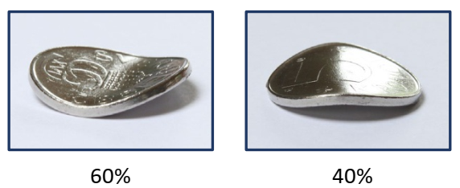


Two Doctrines of Probability
FREQUENTISM
Objective Probability
Probability = physical property (like weight)
Defined as limit of infinite repetitions
θ is fixed but unknown constant
Notation: $p(x | θ)$— θ controls the density
Choose θ̂ to maximize likelihood of data
Leads to Maximum Likelihood Estimation (MLE)
BAYESIANISM
Subjective Probability
Probability = degree of belief
No experiment needed
θ is a random variable itself
Notation: $p(x|θ)$ — θ has its own distribution
Choose θ̂ with max a posteriori probability
Leads to Maximum A Posteriori (MAP)

Slide 5


MLE vs MAP Estimation
Maximum Likelihood Estimation (MLE)
$θ ̂(D) = argmax ∏ p(x | θ)$
Choose parameter θ to maximize the probability (likelihood) of observing the dataset D.
Maximum A Posteriori Estimation (MAP)
$θ ̂(D) = argmax p(θ | D) ∝ p(D | θ) · p(θ) (Bayes′ Law)$
Choose parameter θ to maximize the posterior probability given observations D. Requires a prior distribution p(θ).
Key Difference: In classical statistics θ is a constant; in Bayesian statistics θ is a random variable with its own distribution.

Slide 6



Unbiased Estimator — Definition
An estimator $\tilde{θ}$is unbiased if its expectation equals the true parameter:
$$E\{\tilde{θ}̂\} = E\{θ ̂(x₁,…,xₙ)\} = ∫···∫ θ ̂(x₁,…,xₙ) p(x₁|θ)···p(xₙ|θ) dx₁…dxₙ =! θ$$
Classical Statistics
θ is a fixed constant x₁,…,xₙ are i.i.d. with p(x|θ) Unbiased iff E{$\tilde{θ}$̂} = θ
Bayesian Statistics
θ is a random variable x₁,…,xₙ are i.i.d. with p(x|θ) Unbiased iff E{̂$\tilde{θ}$} = E{θ}

Slide 7

Cramér–Rao Bound
The minimum variance achievable by any unbiased estimator:
$Var\{θ ̂\} ≥ 1 / [ N · E\{(∂/∂θ ln⁡p(x|θ))²\} ] = 1 / [ N · J(θ) ]$
Prerequisites:
1
2
3
4
5
θ̂ is unbiased
θ̂ does not depend on unknown θ
E{θ̂²} < ∞
p(x|θ) is differentiable w.r.t. θ
Regularity conditions hold
CR-Efficient Estimator: An estimator whose variance equals this bound for all θ — the best possible unbiased estimator.

Slide 8


Fisher Information
Definition
The score measures how much θ influences the density of “x”:
$Score = ∂/∂θ ln⁡p(x|θ)$
Fisher information J(θ) is the variance of the score:
Since E{score} = 0, variance = second moment.
Key Properties
Expected Score = 0
$E\{∂/∂θ ln⁡p(x|θ)\} = 0$
CRB Link
$Var\{θ ̂\} ≥ 1/(N·J(θ))$
Multidimensional
$Cov\{θ ̂\} ≥ (1/N) J⁻¹(θ)$
Matrix Form
$J⁻¹(θ) = E\{(∇θ ln⁡p)(∇θ ln⁡p)ᵀ\}$

Slide 9
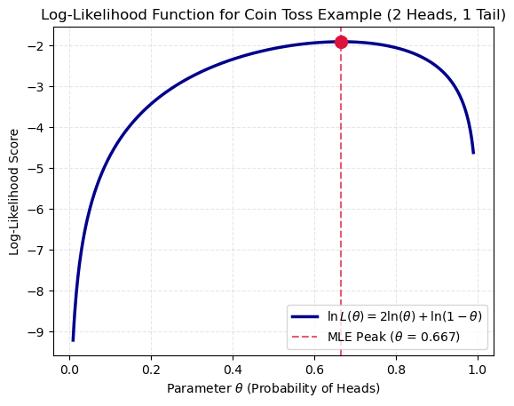
Fisher Information
Suppose we flip a coin 3 times to determine the probability of Head (θ)
We observe the coin and get 2 Heads and 1 Tail

Slide 10


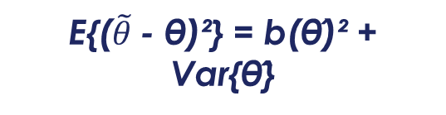
Consistency & Bias-Variance Tradeoff
Consistent Estimator
$$\lim_{N→∞}{Pr⁡(||θ ̂ − θ|| ≥ ε)} = 0 for all ε > 0$$
Estimator converges to true value as N → ∞
Bias
Variance
MSE
b(θ̂) = E{𝜃 ̃ } - θ
Var{θ̂} = E{($\tilde{θ}$- E{θ̂})²}
E{($\tilde{θ}$- θ)²} = b(θ̂)² + Var{θ̂}
Systematic error. Remains even with infinite samples.
Cannot be reduced by adding more data.
Stochastic error. Decreases with more samples.
Can be reduced by increasing N.
Mean Squared Error = bias² + variance. A biased low-variance estimator can beat an unbiased high-variance one!

Slide 11

Example: Empirical Mean Estimator
The Estimator $\tilde{μ} = \frac{1}{N}\sum_{i=1}^{N}{x_{i}}$
The expectation of this estimator is
$E\{\tilde{μ}\} = E \{\frac{1}{N}\sum_{i=1}^{N}{x_{i}}\}=\frac{1}{N}\sum_{i=1}^{N}{E\{x_{i}}\} =\frac{1}{N}\sum_{i=1}^{N}{μ} =μ$
The Expectation is unbiased ✓
Variance of the Estimator
$$E\{{(μ−\tilde{μ})}^{2}\}= E \{{[\frac{1}{N}\sum_{i=1}^{N}{{(x}_{i} − μ)}]}^{2}\}=\frac{σ^{2}}{N}$$
The Variance decrease when N increase ✓

Slide 12
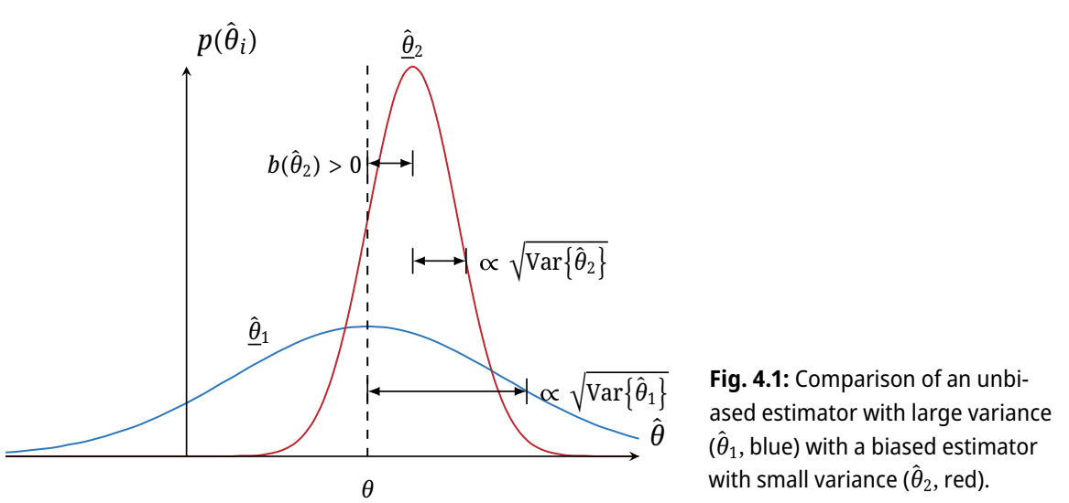
Bias-Variance Tradeoff

Slide 13
Maximum Likelihood Estimation (MLE)
Section 4.1

Slide 14
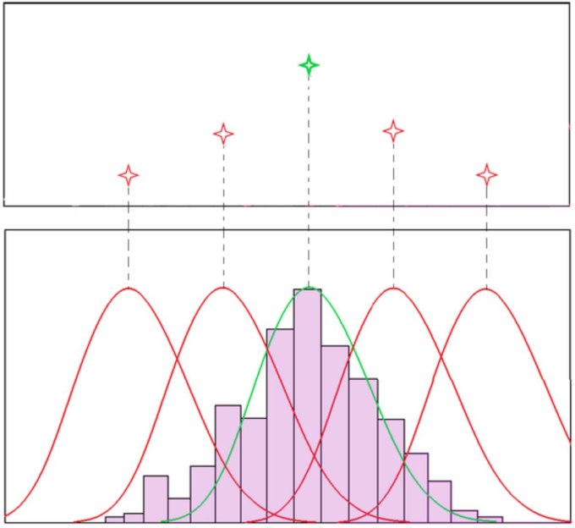

Likelihood Functions
Likelihood
Given xᵢ (i=1,…,N) i.i.d. with p(x|θ), dataset D = {x₁,…,xₙ}:
Likelihood function — product of densities over all samples in D.
$L(θ) = ∏ p(x|θ)$
Log-likelihood — sums instead of products; same extremal points (monotone log).
$l(θ) = ln⁡L(θ) = Σ ln⁡p(x|θ)$

Slide 15

Likelihood Functions
ML Estimator
The ML estimator maximizes the likelihood:
$${\hat{θ}}_{ml }(D) = \underset{\text{θ}\text{∈ }\text{Θ}}{argmax}{\prod_{\text{x}\text{∈ }\text{D}}{\text{p}\text{(}\text{x}\text{|}\text{θ}\text{)}}}$$
$$= argmax Σ ln⁡p(x|θ)$$
Necessary Condition (smooth functions):
$${\text{∇}}_{\text{θ}} l(\text{θ}\text{) = }\sum{{\text{∇}}_{\text{θ}}} ln p(x|\text{θ} \text{)}\text{ =! }\text{0}$$
Set gradient of log-likelihood to zero and solve for θ.
Why log-likelihood? Sums are easier to differentiate than products!

Slide 16

MLE for Gaussian: Estimating μ (Σ known)
Setup
Let $xₖ \sim N(μ, Σ)$with μ unknown, $Σ known. θ = μ$.
$$ln⁡p(xₖ) = −½(xₖ−μ)ᵀΣ⁻¹(xₖ−μ) − d/2·ln⁡2π − ½ ln⁡det⁡Σ$$
Taking gradient with respect to μ:
$$∇μ ln⁡p(xₖ) = Σ⁻¹(xₖ − μ)$$
Applying necessary condition :
$Σᵢ Σ⁻¹(xₖ − μ ̂) = 0 ⟺ Σᵢ(xₖ − μ ̂) = 0$
Result
μ̂ₘₗ = (1/N) Σₖ xₖ
The ML estimator for the mean is the empirical average — regardless of Σ!
This result holds for many distribution families.
✓ Matches empirical mean!

Slide 17

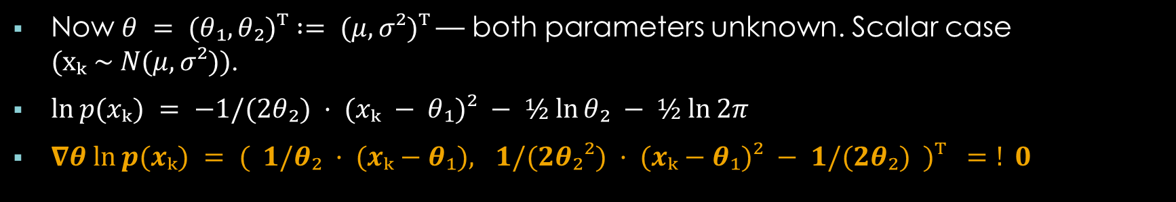

MLE for Gaussian: Estimating μ and σ²
Now $θ = (θ₁, θ₂)ᵀ := (μ, σ²)ᵀ$— both parameters unknown. Scalar case $(xₖ \sim N(μ, σ²))$.
θ₁ = μ̂ₘₗ
$$μ_{ml}= \frac{1}{N} \sum_{k=1}^{N}{x_{k}}$$
Same as before — empirical mean.
θ₂ = σ̂²ₘₗ
$${\hat{σ}}_{ml}^{2} = \frac{1}{N} \sum_{k=1}^{N}{{(x_{k}−μ_{ml})}^{2}}$$
Biased! True unbiased version uses (N-1).
${\hat{σ}}_{ml}^{2}$ is biased! Unbiased estimator: $\frac{N}{N−1}{\hat{σ}}_{ml}^{2}$. Both estimators are consistent.

Slide 18
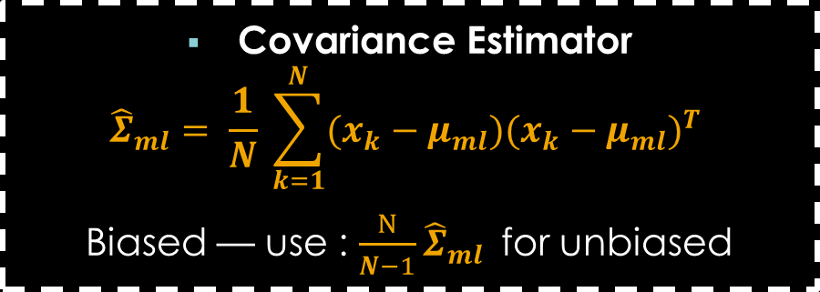

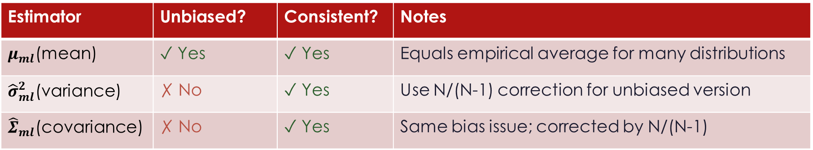
MLE Results Summary - Gaussian Distribution
Multidimensional Case: xₖ ~ N(μ, Σ), both μ and Σ unknown
Mean Estimator
$$μ_{ml}= \frac{1}{N} \sum_{k=1}^{N}{x_{k}}$$
Empirical mean — always unbiased
Covariance Estimator
$${\hat{Σ}}_{ml}= \frac{1}{N} \sum_{k=1}^{N}{(x_{k}−μ_{ml}){(x_{k}−μ_{ml})}^{T}}$$
Biased — use : $\frac{N}{N−1}{\hat{Σ}}_{ml}$for unbiased
Estimator | Unbiased? | Consistent? | Notes
$μ_{ml}$(mean) | ✓ Yes | ✓ Yes | Equals empirical average for many distributions
${\hat{σ}}_{ml}^{2}$(variance) | ✗ No | ✓ Yes | Use N/(N-1) correction for unbiased version
${\hat{Σ}}_{ml}$(covariance) | ✗ No | ✓ Yes | Same bias issue; corrected by N/(N-1)

Slide 19
Bayesian Estimation of the Class-Specific Distributions
Section 4.2

Slide 20
Overview
Classical Approach
Treats theta as a fixed, unknown constant
Estimates theta directly from the dataset
Starts from ML (maximum likelihood)
Parameter vector is deterministic
Bayesian Approach
Treats theta as a random quantity
Estimates parameter directly from the given data
Starting point: classifying unknown objects
Parameter is an intermediate link between training samples and unknown
vs

Slide 21

MAP Parameter Estimation for a Univariant Gaussian Distributions
Setup:
Given a dataset D = {x₁,…,xₙ}
We assume a joint probability $p(D|θ)$, where $θ$ is a random variable
Our gall is to choose a good value of $θ$ that represent the data
MAP say, we can choose $θ_{MAP} = \underset{θ}{argmax}{p(θ|D)}$
Remember for MLE, $θ_{MLE} = \underset{θ}{argmax}{p(D|θ)}$

Slide 22

MAP Parameter Estimation for a Univariant Gaussian Distributions
Given a dataset D = {x₁,…,xₙ}, where each point is a univariant and the data is sampled from a gaussian distribution.
We suppose that$θ$ is a random variable and has the distribution $θ \sim Ν (μ_{0}, 1)$
So we have $p\left(x_{1},x_{2}, …..,x_{n}\right)= \prod_{i=1}^{N}{P(x_{i}|θ)}$
$θ_{MAP} = \underset{θ}{argmax}{p(θ|D)}=\underset{θ}{argmax}{\frac{p\left(D | θ\right)∗p(θ)}{p(D)}}=\underset{θ}{argmax}{p\left(D | θ\right)∗p(θ)}$
$=\underset{θ}{argmax}{\{\ln\left(p\left(D | θ\right)\right)+\ln{(}p(θ)})\}$
To find $θ$ that maximize $θ_{MAP}$we need to calculate the differentiation of $θ_{MAP}$with respect to $θ$ and let it equals zero ${\frac{∂}{∂θ}θ}_{MAP} =0$

Slide 23

MAP Parameter Estimation for a Univariant Gaussian Distributions
$=\underset{θ}{argmax}{\{\ln\left(p\left(D | θ\right)\right)+\ln{(}p(θ)})\}$
From MLE we calculate
$$\ln\left(p\left(D | θ\right)\right)= \frac{1}{σ^{2}}(\sum_{i=1}^{N}{x_{i}}−Nθ)$$
$p\left(θ\right)= \frac{1}{\sqrt{2π}}e^{−\frac{1}{2}{(θ−μ_{0})}^{2}}$ $→\ln{p\left(θ\right)}=−\frac{1}{2}\ln\left(2π\right)−\frac{1}{2} {(θ−μ_{0})}^{2}$
$\frac{∂}{∂θ}\ln{p\left(θ\right)}=\left(μ_{0}−θ\right)$
So ${\frac{∂}{∂θ}θ}_{MAP}=\frac{1}{σ^{2}}\left(\sum_{i=1}^{N}{x_{i}}−Nθ\right)+\left(μ_{0}−θ\right)=0$
$\left(\frac{N}{σ^{2}}+1\right)θ= \frac{\sum_{i=1}^{N}{x_{i}}}{σ^{2}}+μ_{0}$
$θ_{MAP}= \frac{N}{N+σ^{2}}{ μ}_{MLE}+\frac{σ^{2}}{N+σ^{2}}μ_{0}$ where $μ_{MLE}= \frac{1}{N}\sum_{i=1}^{N}{x_{i}}$

Slide 24

MAP Parameter Estimation for a Univariant Gaussian Distributions
Now, if $θ \sim Ν (μ_{0},σ_{0}^{2})$ then we get
$p\left(θ | D\right)= \frac{1}{\sqrt{2}πσ_{N}^{2}} \exp{\{−\frac{1}{2}{(\frac{θ−μ_{N}}{θ_{N}})}^{2}\}}$
$μ_{N}=\left(\frac{Nσ_{0}^{2}}{Nσ_{0}^{2}+σ^{2}}\right)μ_{MLE}+\left(\frac{σ^{2}}{Nσ_{0}^{2}+σ^{2}}\right)μ_{0}$
$σ_{N}^{2}=\left(\frac{σ^{2} σ_{0}^{2}}{Nσ_{0}^{2}+σ^{2}}\right)$

Slide 25



Limiting Behavior as N → ∞
Special cases with respect to the sample number N:
N = 0 (no data)
$$μ_{N}= μ₀ and{ σ}_{N}^{2}= σ₀²$$
Distribution equals the prior — a reasonable result.
$$\lim_{n→∞}\left(μ_{N}\right)=\lim_{n→∞}(\frac{1}{N}\sum_{k=1}^{N}{x_{k}})$$
Posterior mean → ML estimate (empirical mean)
$$\lim_{n→∞}\left(σ_{N}^{2}\right)= 0$$
Posterior variance vanishes — estimation uncertainty disappears
Conclusion:
For large N, any resemblance to the prior vanishes.
The result depends solely on data and equals the ML estimator.
The a posteriori converges to a Dirac at the empirical mean.

Slide 26
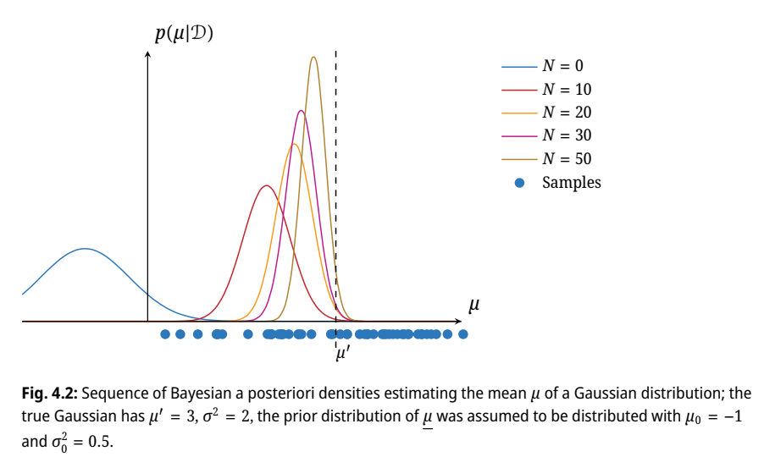
The Effect of dataset size

Slide 27
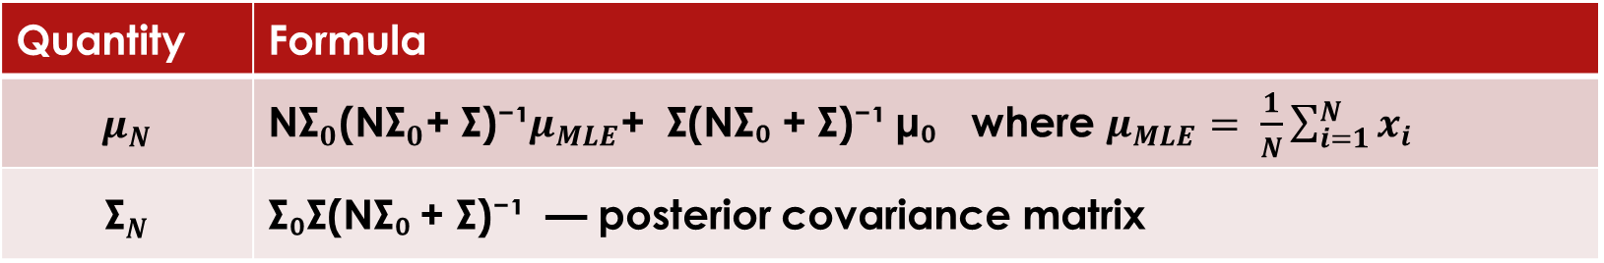


Multivariate Gaussian Case
Straightforward generalization: x ~ N(μ, Σ) with mean μ ~ N(μ₀, Σ₀). The a posteriori of μ is:
$p(μ | D) = α exp⁡\{ −½ (μ −μ_{N})ᵀΣ_{N}^{−1} (μ −μ_{N}) \}$
Quantity | Formula
$$μ_{N}$$ | N${\text{Σ}}_{0}$(N${\text{Σ}}_{0}$+ Σ)⁻¹$μ_{MLE}$+ Σ(NΣ₀ + Σ)⁻¹ μ₀ where $μ_{MLE}= \frac{1}{N}\sum_{i=1}^{N}{x_{i}}$
$${\text{Σ}}_{N}$$ | Σ₀Σ(NΣ₀ + Σ)⁻¹ — posterior covariance matrix
The multivariate feature distribution (analogous to Eq. 4.53) equals:
$p(x | D) is N(μ_{N}, Σ +{\text{Σ}}_{N})$

Slide 28
Summary: Principal Steps of the Bayesian Approach
Performed for each class ωᴵ, i = 1, …, c:
1
Structural Model
p(x | θᴵ, ωᴵ) is assumed structurally known; θᴵ is a random quantity.
2
A Priori Knowledge
p(θᴵ | ωᴵ) encodes prior knowledge about θᴵ.
3
Dataset as Evidence
Dᴵ is i.i.d. feature vectors $X_{k}$ ~ p(x | θᴵ, ωᴵ). p(Dᴵ | θᴵ, ωᴵ) = ∏ p($X_{k}$ | θᴵ, ωᴵ)
4
A Posteriori of θ
p(θᴵ|Dᴵ,ωᴵ) = p(Dᴵ|θᴵ,ωᴵ)p(θᴵ|ωᴵ) / ∫ p(Dᴵ|θᴵ,ωᴵ)p(θᴵ|ωᴵ)dθᴵ

Slide 29
Bayesian vs. Maximum Likelihood Estimation
Bayesian vs. Maximum Likelihood Estimation
Prior Knowledge
Bayesian: Allows bringing in prior knowledge about the parameter vector through p(θ).
ML: Does not incorporate prior knowledge about the parameter.
Computational Complexity
Bayesian: Requires numerical calculation of multi-dimensional integrals.
ML: Simpler — one needs only to find an extremum of the likelihood.
Next: Section 4.3 — Bayesian Parameter Estimation (MAP & Bayes estimators)

Slide 30
Bayesian Parameter Estimation
Section 4.3

Slide 31
ML vs. Bayesian: Core Idea
Maximum Likelihood (ML)
Goal: Find the single best parameter value θ̂ to plug into the parametric density p(m | θ). Output: A single point estimate θ̂ Advantage: Simpler — only find an extremum Limitation: Cannot incorporate prior knowledge about θ
Bayesian Estimation
Goal: Compute the full a posteriori distribution p(θ | D) — not just a single value Output: A complete posterior distribution Advantage: Allows bringing in prior knowledge p(θ | ω) Challenge: Requires numerical computation of multidimensional integrals
vs

Slide 32

Estimation via Minimizing Expected Cost
Find θ̂(D) that minimizes the expected cost: $E\{ l( θ ̂(D), θ ) \}$
θ is the a posteriori parameter, “$l$” is a cost (loss) function
Least Squared Error
Cost function: l(θ̂, θ) = (θ̂ − θ)ᵀ(θ̂ − θ) Minimizing E{ ‖θ̂(D) − θ‖² } gives: θ̂(D) = E{ θ | D }
→ A posteriori expectation of θ
Constant Penalty (0/1 Loss)
Cost function: l(θ̂, θ) = 0 if ‖θ̂ − θ‖ < Δ l(θ̂, θ) = 1 otherwise As Δ → 0, minimizing E{l} gives: θ̂(D) = argmax p(θ | D)
→ Maximum A Posteriori (MAP) estimator

Slide 33
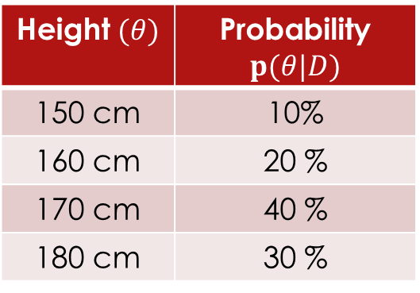



Example
Imagine you are guessing the height of a person in “cm” based on some data.
And the Bayesian estimation give us the following $p(θ)$
Least Squared Error
Calculate the average of $p(θ|D)$
$\left(150 ×0.10\right)=15$
$\left(160 ×0.20\right)=32$
$\left(170 ×0.40\right)=68$
$\left(180 ×0.30\right)=54$
$LSE Guess=15+32+68+54=169 cm$
MAP
Find the most probable
$150 cm →10\%$
$160 cm →20\%$
$170 cm →40\%→highest$
$180 cm →30\%$
MAP Guess = 170 cm
Height $(θ)$ | Probability $p(θ|D)$
150 cm | 10%
160 cm | 20 %
170 cm | 40 %
180 cm | 30 %

Slide 34
The Simple Rule
LSE:
Cares about being close on average.
To get the lowest squared error, we choose the average (mean) of the Bayesian spectrum.
MAP
Care about being the most often exactly right
To get the lowest penalty, we need to choose the highest peak of the Bayesian spectrum.
Method | What it does
LSE | Weighted average (Mean)
MAP | Pick the most likely single value (Mode)

Slide 35
4.4 Sources of Error in Bayesian Classification
Bayesian classification is optimal — but not error-free. Three distinct error types arise:
Bayesian / Indistinguishability Error
Overlapping class-specific feature distributions — at least two classes share feature values. Features are not perfectly discriminative. Solution: Find more powerful features.
Model Error
An unsuitable parametric model was chosen (e.g., assumed Gaussian but data is uniform). Estimation runs but produces results for the wrong model. Solution: Expert knowledge + model-fit tests.
Estimation Error
Too few samples relative to the number of parameters — estimates become unreliable. Remedy: gather more samples (costly) or reduce the number of parameters (limited by feature quality).

Slide 36
MLE and MAP Summary
Bayesian ≠ ML: Bayesian yields a full posterior distribution, not a single point estimate.
Prior knowledge: The Bayesian approach naturally incorporates prior p(θ | ω); ML does not.
Cost functions: Different loss functions lead to different estimators (LSE → posterior mean; 0/1 → MAP).
MAP estimator: θ̂ = argmax p(θ | D) — maximizes the posterior; bridges Bayesian and ML thinking.
Three error types: Indistinguishability · Model · Estimation — each requires a different remedy.

Slide 37
MLE vs MAP
Example

Slide 38

Parameter Estimation: MLE vs MAP
Imagine you have a coin, and you want to estimate its probability of landing heads, which we will call θ.
You flip the coin 10 times, and it lands on heads 7 times (and tails 3 times).
Maximum Likelihood Estimation (MLE)
MLE only cares about the data you just observed.
It asks: "What value of θ makes getting 7 heads out of 10 flips most likely?"
The probability of getting 7 heads out of 10 flips follows a Binomial distribution:
$$p\left(θ | D\right)=\left(\begin{matrix}10 \\ 7\end{matrix}\right)θ^{7}{(1−θ)}^{3}$$

Slide 39

Parameter Estimation: MLE vs MAP Maximum Likelihood Estimation (MLE)
To find the maximum, we take the log (to make the math easier), take the derivative with respect to θ, and set it to 0.
Log-Likelihood:
ln P(Data | θ) = ln($\left(\begin{matrix}10 \\ 7\end{matrix}\right)$) + 7 ln(θ) + 3 ln(1 - θ)
Take the Derivative:
d/dθ [ln P(Data | θ)] = 7/θ - 3/(1 - θ)
Set to Zero and Solve:
7/θ = 3/(1 - θ) → 7(1 - θ) = 3θ → 7 - 7θ = 3θ ⇒ 10θ = 7 → θ_{MLE} = 0.7
MLE Result: The coin has a 70% chance of landing heads. It bases this purely on the data.

Slide 40

Parameter Estimation: MLE vs MAP Maximum A Posteriori (MAP)
Maximum A Posteriori (MAP)
MAP introduces a prior belief. Let’s say you are pretty sure this is a fair coin, so you expect θ to be around 0.5.
We can represent this prior belief using a Beta distribution. Let's pick a prior that acts like 4 "imaginary" flips (2 heads, 2 tails). This pushes our estimate toward 0.5.
Prior function: P(θ) ∝ θ² (1 - θ)²
P(θ | Data) ∝ [$\left(\begin{matrix}7 \\ 10\end{matrix}\right)$θ⁷ (1 - θ)³ ] × [ θ² (1 - θ)² ] = θ⁹ (1 - θ)⁵
Notice how the exponents just added together? It's like we now have 9 heads and 5 tails total.

Slide 41
Parameter Estimation: MLE vs MAP Maximum A Posteriori (MAP)
Log-Posterior:
ln P(θ | Data) = 9 ln(θ) + 5 ln(1 - θ) + constant
Take the Derivative:
d/dθ [ln P(θ | Data)] = 9/θ - 5/(1 - θ)
Set to Zero and Solve:
9/θ = 5/(1 - θ) → 9(1 - θ) = 5θ → 9 - 9θ = 5θ ⇒ 14θ = 9 → θ_{MAP} = 9/14 ≈ 0.643
MAP Result: The coin has roughly a 64.3% chance of landing heads.

Slide 42
Parameter Estimation: MLE vs MAP
Method | Formula to Maximize | Our Result | Explanation
MLE | P(Data | θ) | 0.700 | Strictly trusts the 10 real flips.
MAP | P(Data | θ) P(θ) | 0.643 | Drags the result closer to 0.5 because of our prior skepticism.
Summary of Difference
If you flipped the coin 10,000 times instead of 10, the sheer amount of data would completely overwhelm the prior, and MAP would converge to the exact same answer as MLE.

Slide 43
Parameter Estimation for Gaussian Mixtures
Section 4.5
The Expectation-Maximization (EM) Algorithm

Slide 44


Gaussian Mixture Models
The Density
For each sample point
$$p\left(x\right)= \sum_{k=1}^{K}{z_{k} ∗ Ν (x, }μ_{k},Σ_{k})$$
K mixture components, each a Gaussian
Zₖ = mixing coefficients (weights, sum to 1)
μₖ = component means
Σₖ = component covariances
The Challenge
Log-likelihood is analytically intractable:
$$l\left(θ\right)=\sum_{n=1}^{N}{ln} \sum_{k=1}^{K}{z_{k} ∗ Ν (x_{n}, }μ_{k},Σ_{k})$$
Singularities arise when μₖ collapses onto a datapoint xᵢ — likelihood blows up to ∞
Solution: Expectation-Maximization (EM) Algorithm — iteratively maximizes likelihood in a probabilistically sound way

Slide 45
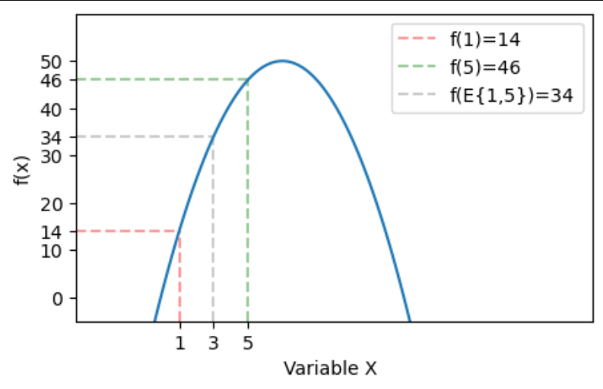


Jensen's Inequality
Let x be an integrable random variable and f : ℝ → ℝ a concave function.
$f\left\{E\left(x\right)\right\}≥E\{f(x)\}$
log- likelihood for GMM is
$$l\left(θ\right)= \sum_{n=1}^{N}{\ln{p(x_{n}|θ)}}$$
$$= \sum_{n=1}^{N}{\ln{ \sum_{Z}{p(x_{n},z_{n}|θ)}}}$$
$$= \sum_{n=1}^{N}{\ln{ \sum_{k=1}^{K}{γ\left(z_{nk}\right)∗ \frac{\sum_{Z}{p(x_{n},z_{n}|θ)}}{γ\left(z_{nk}\right)}}}}$$
Example
$let x=\left\{\begin{aligned}1, probability=0.5 \\ &5, probability=0.5\end{aligned}\right.$

Slide 46
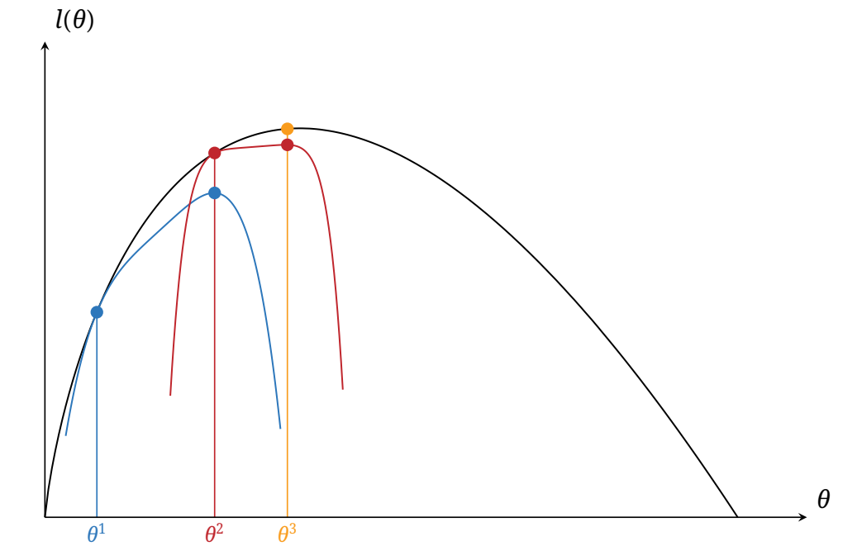

Visualization for E-step and M-step
$$Q(θ)$$

Slide 47
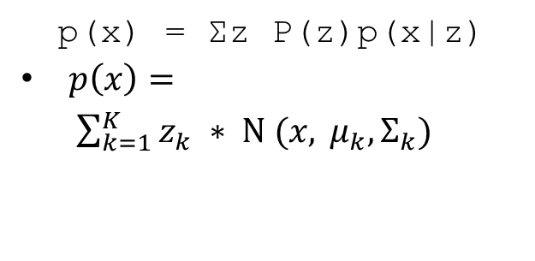

Latent Variable View of Mixture Models
Observed
Latent
Joint
Datapoint xₙ
(visible)
Component zₙ
(hidden, binary K-vector)
p(x) = Σz P(z)p(x|z)
$p\left(x\right)= \sum_{k=1}^{K}{z_{k} ∗ Ν (x, }μ_{k},Σ_{k})$
The Responsibility γ(zₙₖ)
$$γ \left(Z_{nk}\right)=P\left(Z_{k}=1 \right|x_{n})=\text{posterior} \text{of} \text{component} \text{k} \text{for} \text{datapoint} \text{x}\text{ₙ}$$
Jensen's Inequality:
f(E{x}) ≥ E{f(x)} for concave f → enables the lower bound Q(θ)
Interpretation: How much is component k responsible for generating point xₙ? Used to build the expected log-likelihood Q(θ) as a lower bound for l(θ).

Slide 48

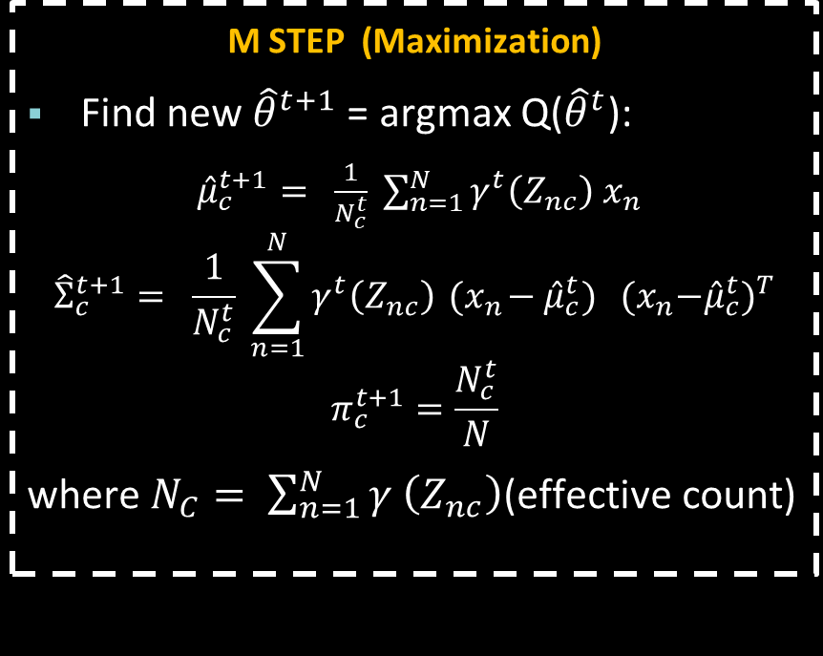
The EM Algorithm — Overview
Initialize model parameters ${\hat{θ}}_{0}=({\hat{π}}_{0},{\hat{μ}}_{0},{\hat{Σ}}_{0})$with random values.
E STEP (Expectation)
Compute responsibilities using current parameters ${\hat{θ}}^{t}$: $γ^{t}\left(Z_{nc}\right)=p \left(z_{n} | x_{n},θ^{t}\right)= \frac{{\hat{π}}_{c}^{t} Ν (x_{n};{\hat{μ}}_{c}^{t},{\hat{Σ}}_{c}^{t})}{\sum_{k=1}^{K}{{\hat{π}}_{k}^{t} Ν (x_{n};{\hat{μ}}_{K}^{t},{\hat{Σ}}_{k}^{t})}}$
This makes the lower bound Q(θ) tight at θ̂ᵗ — Jensen's inequality holds with equality.
M STEP (Maximization)
Find new ${\hat{θ}}^{t+1}$ = argmax Q(${\hat{θ}}^{t}$):
${\hat{μ}}_{c}^{t+1}= \frac{1}{N_{c}^{t}} \sum_{n=1}^{N}{γ^{t}\left(Z_{nc}\right){ x}_{n}}$
$${\hat{Σ}}_{c}^{t+1}= \frac{1}{N_{c}^{t}} \sum_{n=1}^{N}{γ^{t}\left(Z_{nc}\right){ (x}_{n}−{\hat{μ}}_{c}^{t})} {{ (x}_{n}−{\hat{μ}}_{c}^{t})}^{T}$$
$$π_{c}^{t+1}=\frac{N_{c}^{t}}{N}$$
where $N_{C}= \sum_{n=1}^{N}{γ \left(Z_{nc}\right)}$(effective count)
Repeat until $l\left({\hat{θ}}^{t+1}\right)−l\left({\hat{θ}}^{t}\right)≤ε$

Slide 49
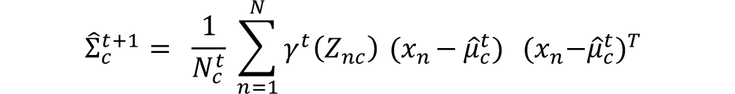

Closed-Form M-Step Updates for GMMs
1
Updated Mean μ̂c
${\hat{μ}}_{c}^{t+1}= \frac{1}{N_{c}^{t}} \sum_{n=1}^{N}{γ^{t}\left(Z_{nc}\right){ x}_{n}}$
Weighted average of all datapoints, weighted by each component's responsibility. Reduces to standard MLE mean when responsibilities are hard (0 or 1).
2
Updated Covariance Σ̂c
$${\hat{Σ}}_{c}^{t+1}= \frac{1}{N_{c}^{t}} \sum_{n=1}^{N}{γ^{t}\left(Z_{nc}\right){ (x}_{n}−{\hat{μ}}_{c}^{t})} {{ (x}_{n}−{\hat{μ}}_{c}^{t})}^{T}$$
Weighted sample covariance, analogous to standard MLE but weighted by responsibilities. Nc = Σₙ γ(zₙc) is the effective data count.
3
Updated Mixing Coeff. π̂c
$$π_{c}^{t+1}=\frac{N_{c}^{t}}{N}$$
Simply the average responsibility taken by component c across all N datapoints — fraction of data "owned" by this component.

Slide 50
EM Algorithm — Complete Procedure
1
Initialize:
Set θ̂⁰ = (π̂⁰, μ̂⁰, Σ̂⁰) randomly
2
E Step:
Compute responsibilities γᵗ(zₙc) for all n, c
3
M Step:
Update μ̂, Σ̂, π̂ using closed-form solutions (Eqs. 4.105)
4
Evaluate:
Compute log-likelihood l(θ̂ᵗ⁺¹); check convergence l(θ̂ᵗ⁺¹) − l(θ̂ᵗ) < ε
5
Repeat:
If not converged, set t = t+1 and return to Step 2

Slide 51
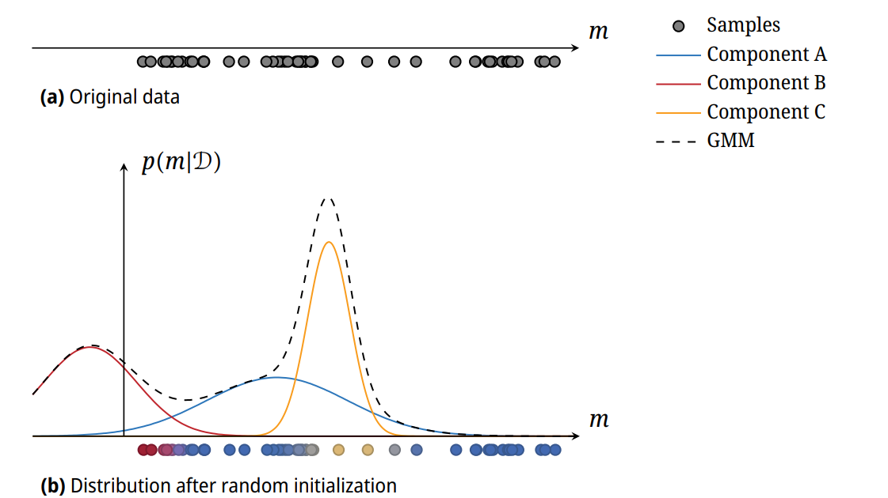
GMM Visual Example

Slide 52
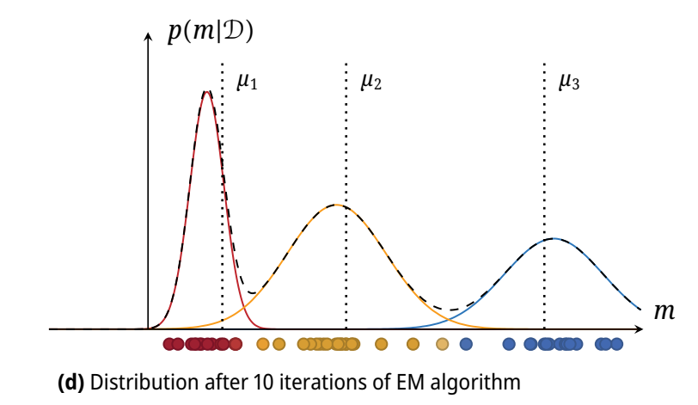
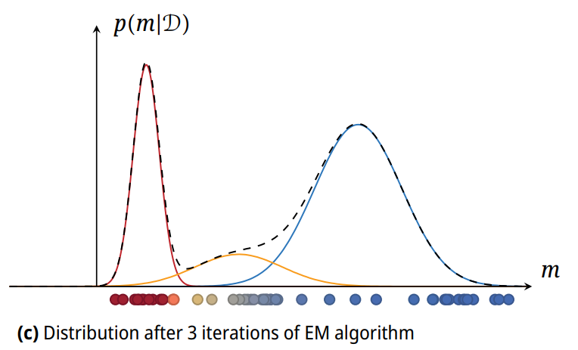
GMM Visual Example

Slide 53
Practical Considerations & Limitations
⚠
Local Optima
⚙
Initialization
EM is not guaranteed to find the global optimum. The log-likelihood function may not be strictly concave.
Convergence speed and quality depend heavily on the starting parameters θ̂⁰.
→ Run EM multiple times with different random initializations.
→ Use k-means clustering to initialize μ, or try multiple random starts.
❓
Number of Components K
✓
Convergence Guarantees
Selecting the optimal K is an open problem — no universal rule.
EM is guaranteed to monotonically increase the likelihood at each iteration.
→ Use heuristics such as the Bayesian Information Criterion (BIC).
→ Provides numerical stability and probabilistic soundness.

Slide 54
EM Summary
GMMs are powerful universal approximators but require iterative estimation
EM alternates between E step (responsibilities) and M step (parameter update)
Closed-form updates exist for μ, Σ, and π in the Gaussian case
Convergence is guaranteed; global optimum is not — use multiple restarts
EM is a general framework — also used in hidden Markov models (Baum-Welch)

Slide 55
Manual GMM Estimation Example Initial Parameter Assumptions
The Setup
Assume we have a 1D dataset containing N = 3 datapoints:
D = { x₁ = 2, x₂ = 3, x₃ = 8 }
Notice that m₁ and m₂ form a tight cluster, while m₃ sits isolated far to the right.
We want to fit a GMM with K = 2 components.
Initial Parameter Assumptions (Iteration 0)
Priors (Weights): π₁ = 0.5, π₂ = 0.5
Means (Centers): μ₁ = 3.0, μ₂ = 7.0
Variances: σ₁² = 1.0, σ₂² = 1.0

Slide 56
Manual GMM Estimation Example Step 1: The E-Step (Expectation)
Step 1: The E-Step (Expectation)
Using Equation 4.103, we evaluate the responsibility γ(z_{nk}) for each point.
First, we compute the raw Gaussian probability densities via
𝒩(x | μ, σ²) = (1 / √(2πσ²)) * e^(-(m-μ)² / 2σ²). Knowing that 1 / √(2π) ≈ 0.4:
For x₁ = 2: 𝒩₁(2|3,1) = 0.4 * e⁻⁰⁵ ≈ 0.242 | 𝒩₂(2|7,1) = 0.4 * e⁻¹²⁵ ≈ 0.000
For x₂ = 3: 𝒩₁(3|3,1) = 0.4 * e⁰ = 0.400 | 𝒩₂(3|7,1) = 0.4 * e⁻⁸ ≈ 0.000
For x₃ = 8: 𝒩₁(8|3,1) = 0.4 * e⁻¹²⁵ ≈ 0.000 | 𝒩₂(8|7,1) = 0.4 * e⁻⁰⁵ ≈ 0.242

Slide 57
Manual GMM Estimation Example Step 1: The E-Step (Expectation)
Normalizing these values yields the definitive responsibility matrix:
Datapoint (x_{n}) | Responsibility of Component 1: γ(z_{n1}) | Responsibility of Component 2: γ(z_{n2})
x₁ = 2 | 0.5(0.242) / [0.5(0.242) + 0] = 1.0 | 0 / [0.5(0.242) + 0] = 0.0
x₂ = 3 | 0.5(0.400) / [0.5(0.400) + 0] = 1.0 | 0 / [0.5(0.400) + 0] = 0.0
x₃ = 8 | 0 / [0 + 0.5(0.242)] = 0.0 | 0.5(0.242) / [0 + 0.5(0.242)] = 1.0
Note: Because our initialized cluster guesses were already separated far apart, the responsibility calculations cleanly split full ownership (1.0 vs 0.0) across the targets.

Slide 58
Manual GMM Estimation Example Step 2: The M-Step (Maximization)
Step 2: The M-Step (Maximization)
Using the responsibilities from the table above, we calculate the brand new parameter adjustments outlined in Equation 4.105.
1. Effective count of points allocated to components (N_{k})
N₁ = 1.0 + 1.0 + 0.0 = 2.0 N₂ = 0.0 + 0.0 + 1.0 = 1.0
2. Update Mixing Coefficients (π_{k})
π₁^{new} = N₁ / N = 2 / 3 ≈ 0.667 π₂^{new} = N₂ / N = 1 / 3 ≈ 0.333

Slide 59
Manual GMM Estimation Example Step 2: The M-Step (Maximization)
3. Update Means (μ_{k})
μ₁^{new} = [(1.0 * 2) + (1.0 * 3) + 0] / 2.0 = 5 / 2 = 2.5 μ₂^{new} = [0 + 0 + (1.0 * 8)] / 1.0 = 8 / 1 = 8.0
4. Update Variances (σ_{k}²)
σ₁²^{, new} = [1.0*(2 - 2.5)² + 1.0*(3 - 2.5)² + 0] / 2.0 = [0.25 + 0.25] / 2.0 = 0.25 σ₂²^{, new} = [0 + 0 + 1.0*(8 - 8.0)²] / 1.0 = 0 / 1 = 0.0
Singularity Warning Realized:
Look at Component 2's new variance: σ₂² = 0.0.
Because Component 2 isolated a single lone point (m₃ = 8) and locked its center center-mass onto it exactly (μ₂ = 8.0), its variance distribution completely collapsed.
Attempting a second step calculation with zero variance triggers division by zero, spinning our likelihood calculations straight out to infinity!

Slide 60
Real-World Parameter Estimation Applications

Slide 61
Real-World Parameter Estimation Applications
Application / Core System | Corporation | What it Predicts / Estimates
Amazon Advertising CTR Model | Amazon | Estimates probability parameters (p_ctr) that a user will click an ad based on shopping query, time, and device context.
Netflix Recommendation Engine | Netflix | Estimates hidden user-preference and movie-characteristic parameters using matrix factorization to predict how much you'll like a title.
Uber Dynamic Pricing (Surge) | Uber | Constantly estimates supply and demand multiplier parameters in real-time based on local rider traffic and available drivers.

Slide 62
Real-World Parameter Estimation Applications
Application / Core System | Corporation | What it Predicts / Estimates
TikTok For You Page (FYP) Algorithm | ByteDance | Estimates dynamic retention weights (parameters) for each user based on millisecond-level watch time and interaction loops.
Google Search Ad Auction (Smart Bidding) | Google | Estimates conversion rate parameters to automatically calculate optimal, real-time keyword bid prices for millions of live advertisers.
Spotify Discover Weekly | Spotify | Estimates acoustic attribute parameters (valence, danceability, energy) of songs alongside user taste profiles to match music preferences.

Slide 63
Real-World Parameter Estimation Applications
Application / Core System | Corporation | What it Predicts / Estimates
Airbnb Search Ranking & Smart Pricing | Airbnb | Estimates booking probability parameters based on seasonal demand, listing prices, and specific amenities.
Meta Ad Relevance Scoring | Meta (Facebook/Instagram) | Estimates parameters determining user ad relevance scores to decide exactly which targeted commercial spots run on a user's feed.

Slide 64


